Slide 1

TECHNORAX V5.0 T-HACK 2.0
Team: Bit_rebels
MEMBERS: Gaurav gupta | rishabh sharma | Vineet jha | SHLOK BANSAL

Slide 2
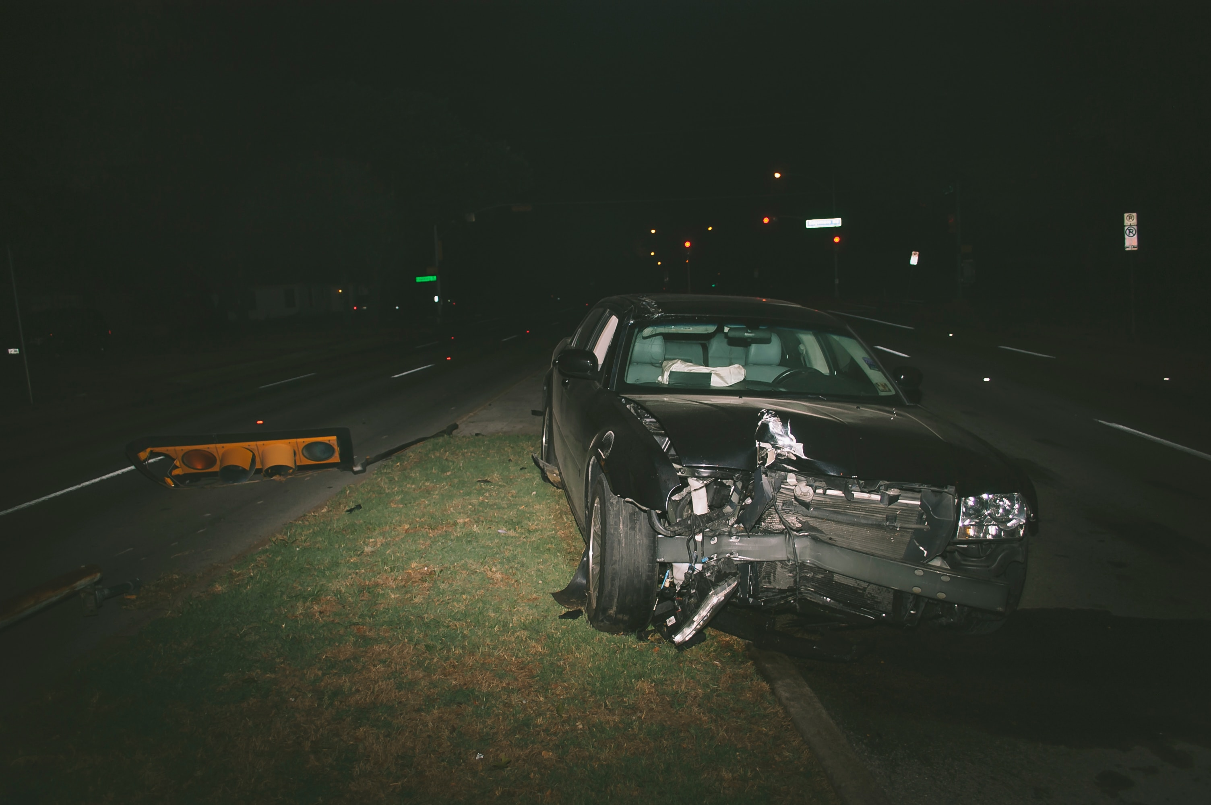
Drowsiness & Sleepy Driving: The Silent Killer on Indian roads
Driving when you are sleepy & exhausted? Well, you're as much of a safety hazard as a
drunk driver. We assume everyone agrees with the fact that, "you're more likely to die from
drowsy driving than from texting while driving, distracted driving or drunk driving
combined".
The effects of drowsiness are similar to alcohol - it will make your driving inputs (steering,
acceleration, braking) poorer, destroy your reaction times & blur your thought processes.
According to data 20% of all fatal accidents in the India are due to drowsiness! We can only
imagine what the stats are like for India which has a higher road accident rate. Problem is,
no one researches this out here. Headlines only scream '​speeding car hits biker'. The Times
of India has merely 800 results for 'sleepy driver', but a whopping 2.23 lakh for 'speeding
car'.

Slide 3
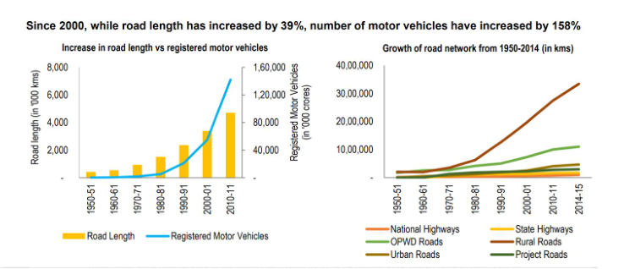
Some recent data suggesting the need of technologies to mitigate such events.

Slide 4
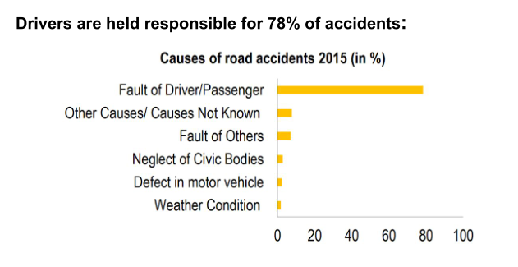
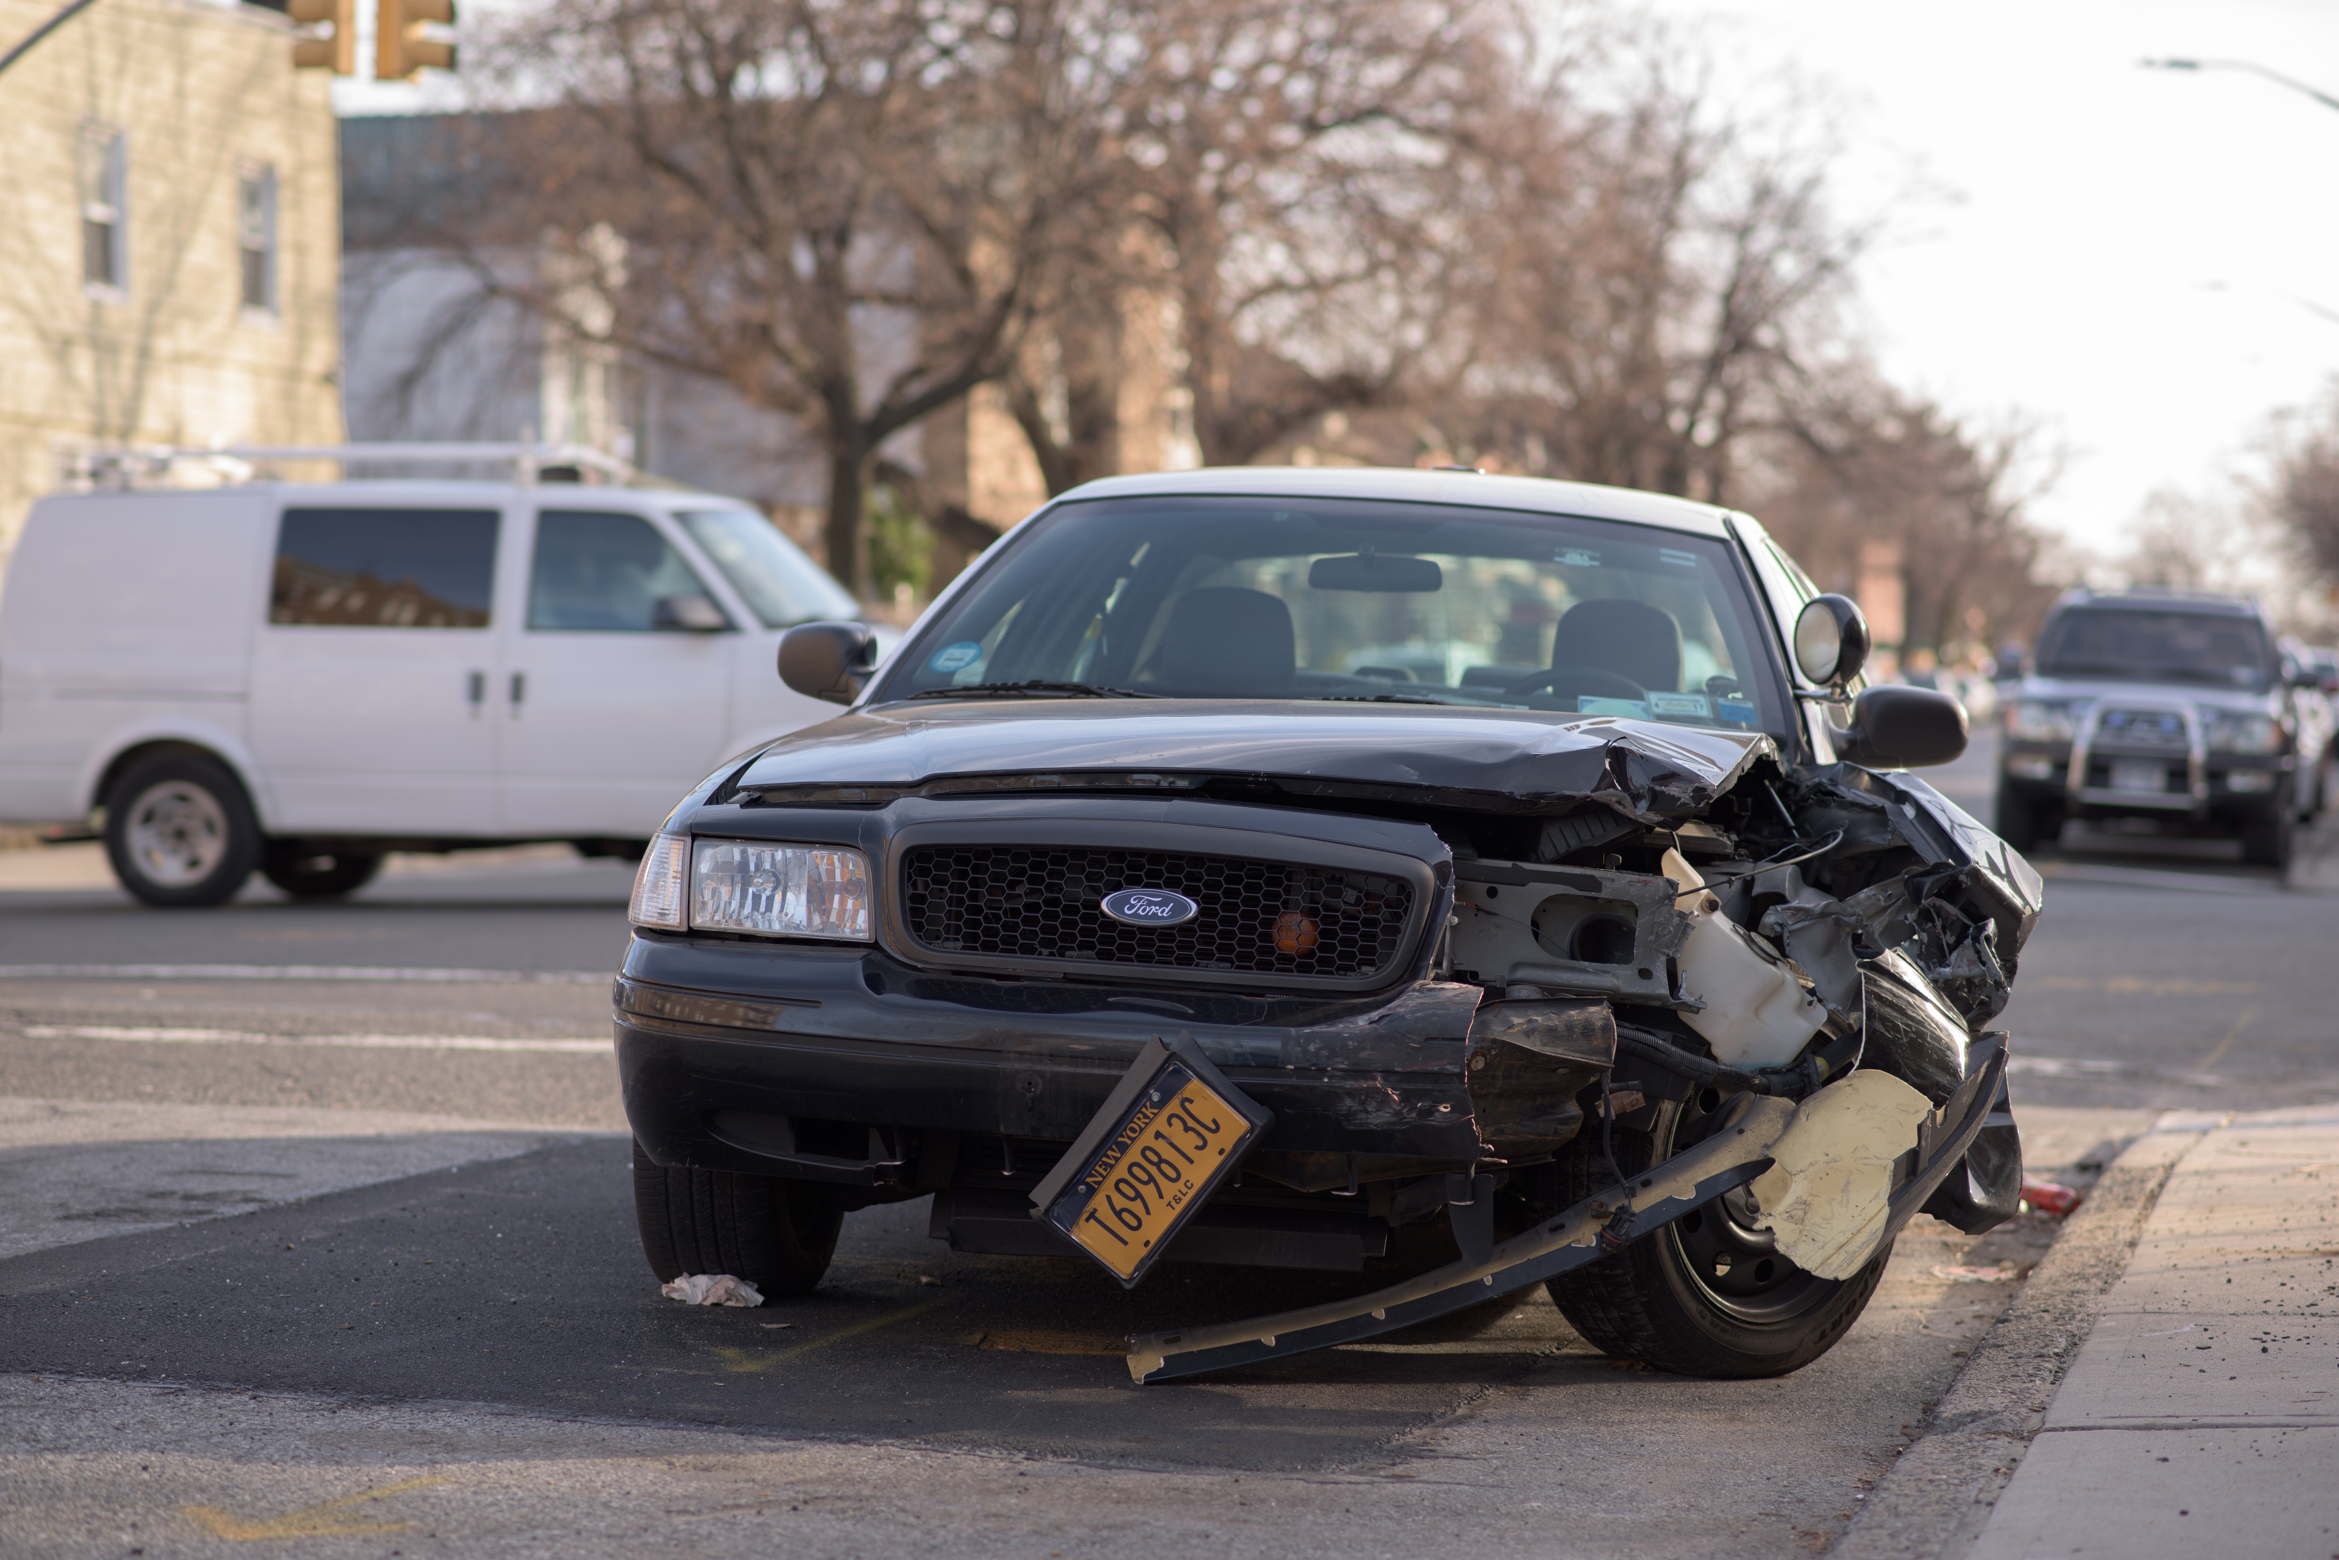
PRIMARY CAUSES OF ROAD ACCIDENTS

Slide 5
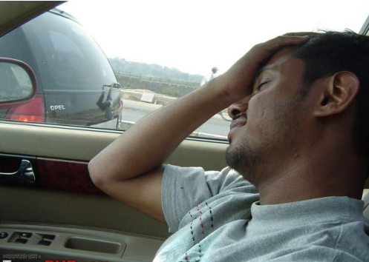
REASONS OF DROWSY-DRIVING​ :
Difficulty focusing, frequent blinking or heavy eyelids
Daydreaming; wandering / disconnected thoughts
Trouble remembering the last few km driven; missing exits or traffic signs
Yawning repeatedly or rubbing your eyes
Trouble keeping your head up
Drifting from your lane, tailgating or hitting a shoulder rumble strip
Feeling restless and irritable

Slide 6
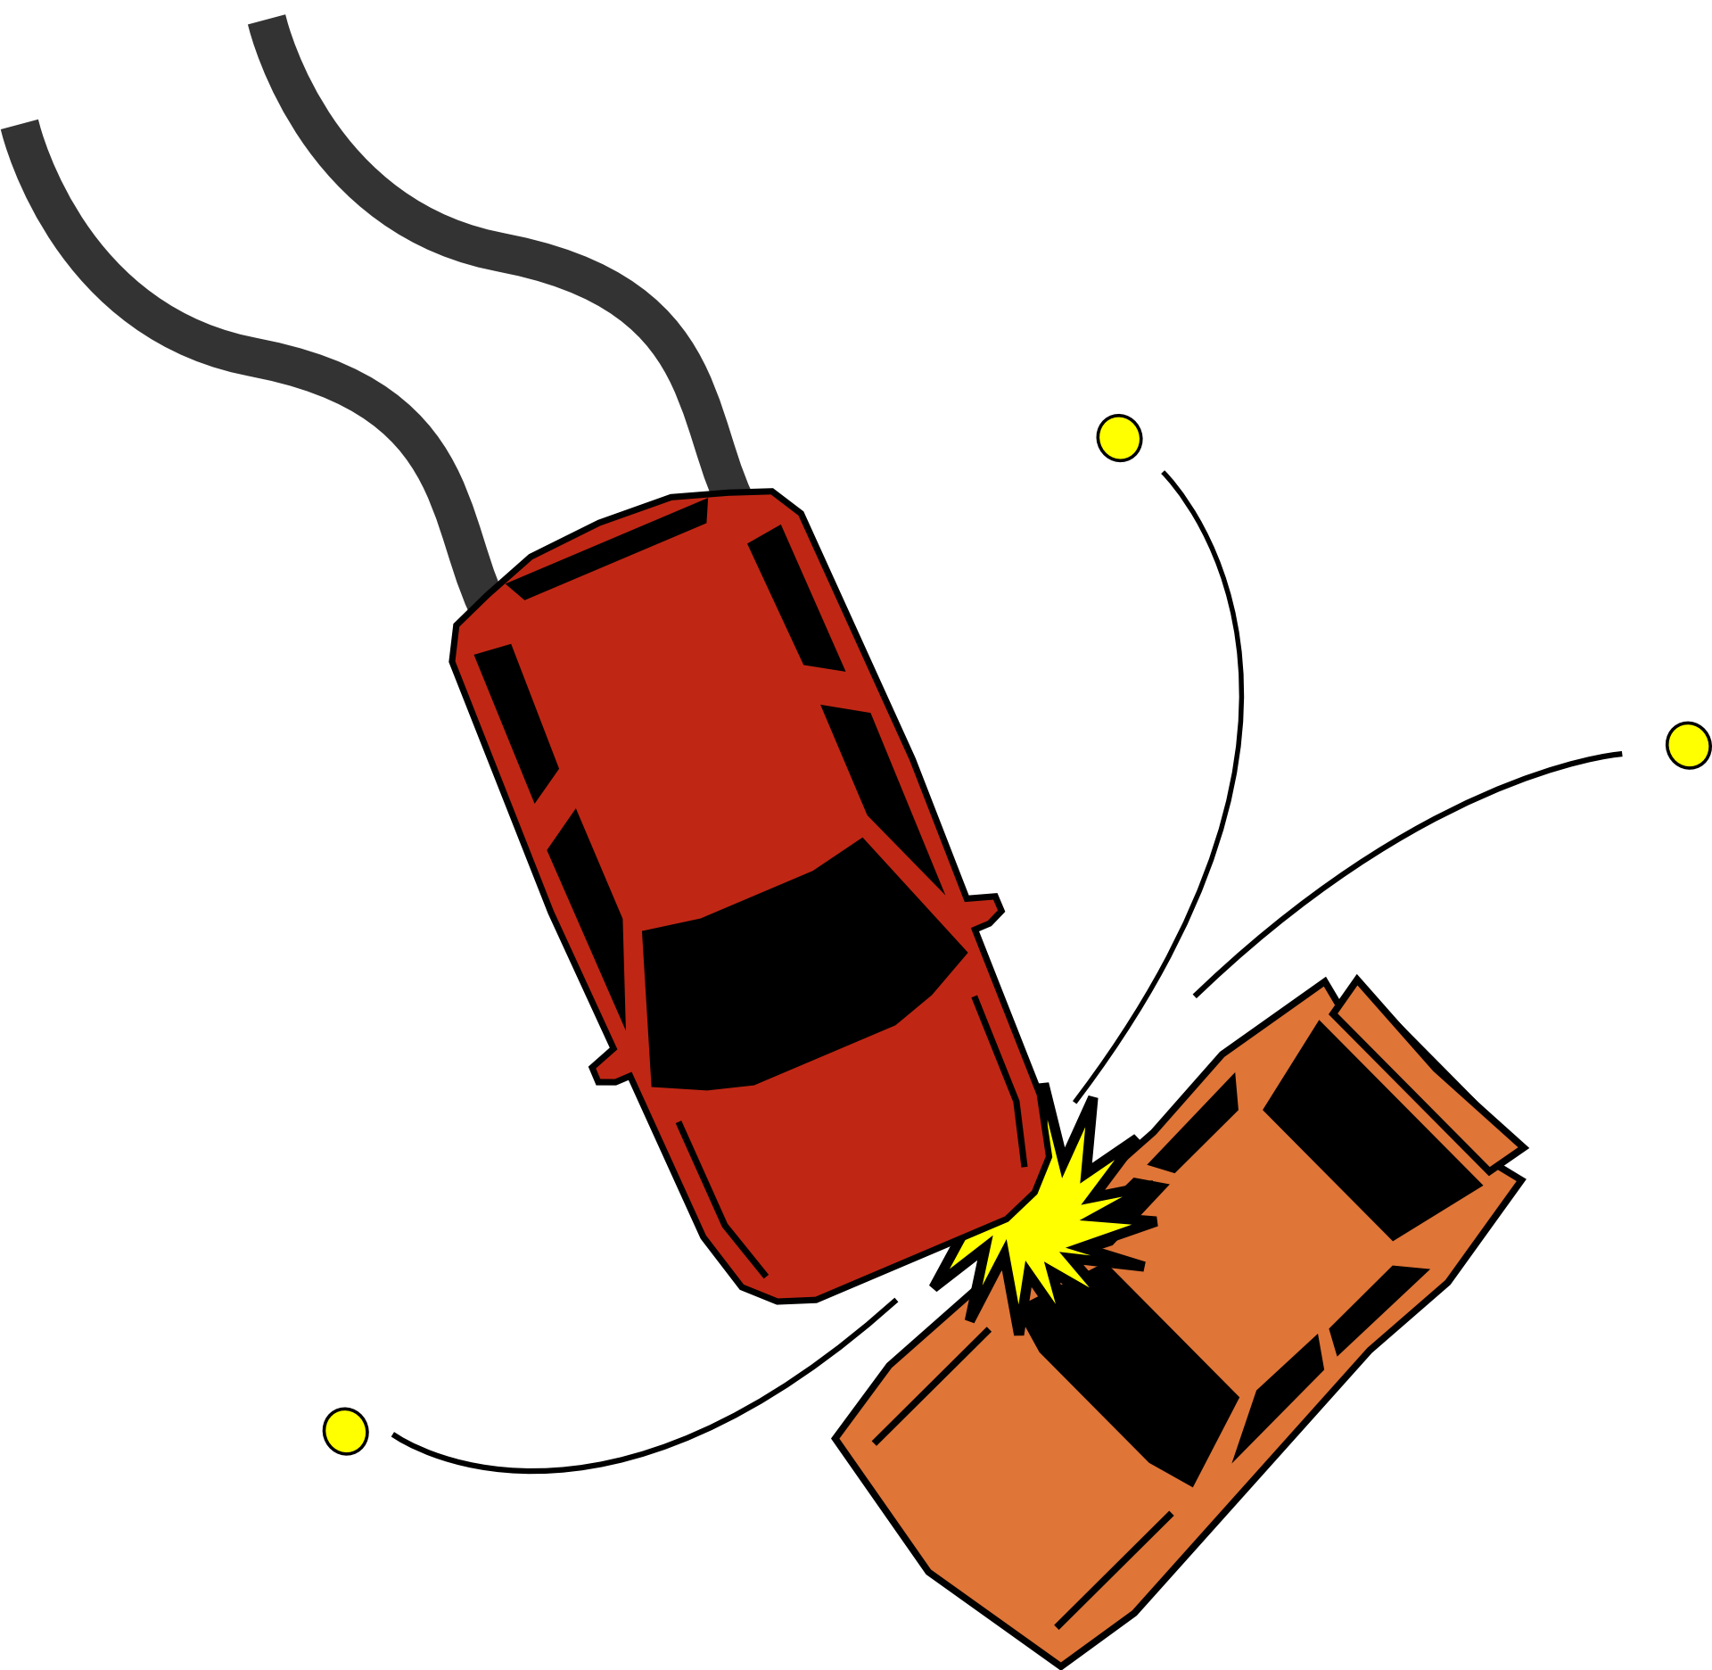
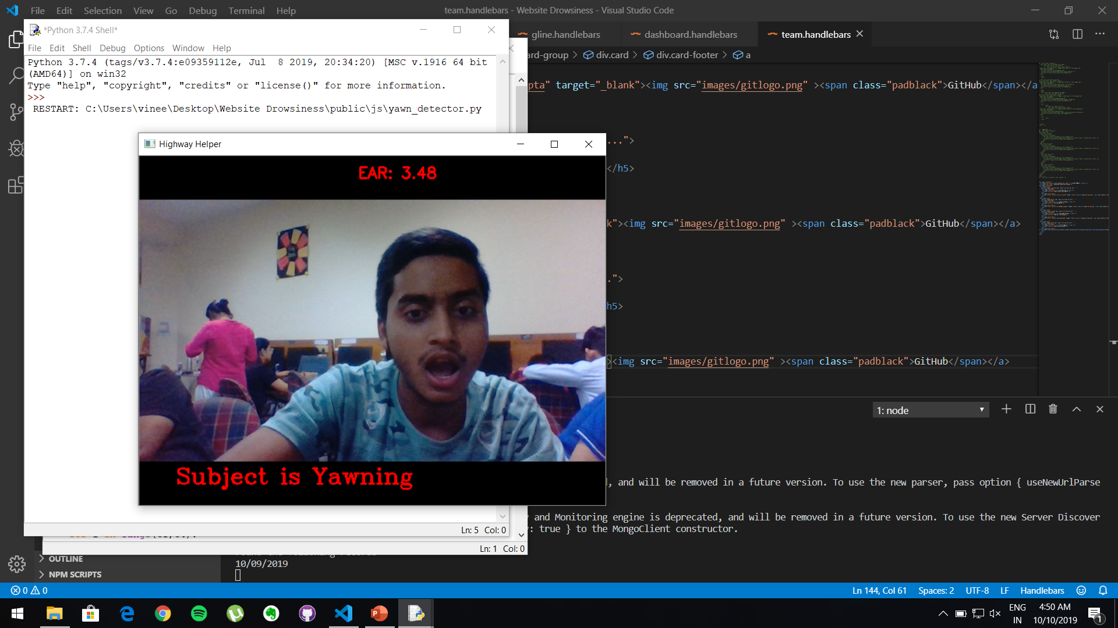
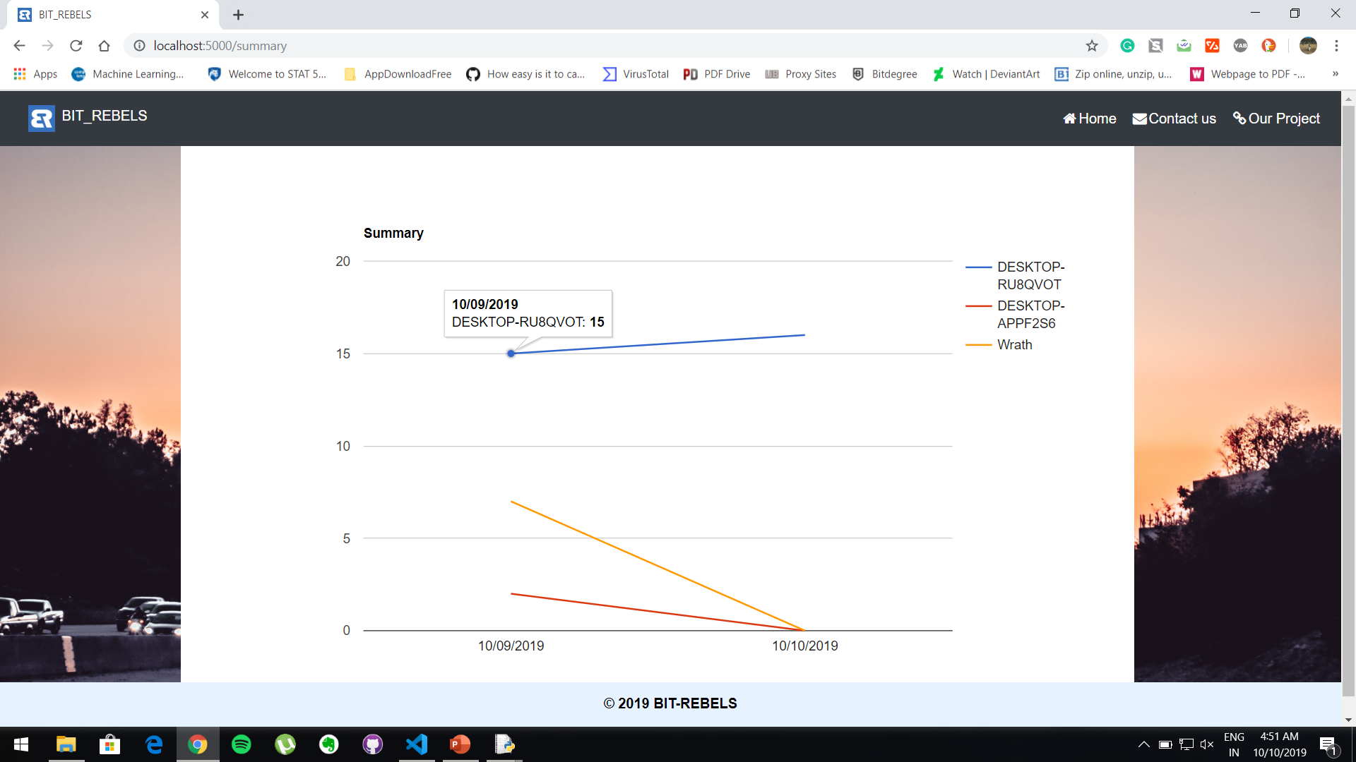
OUR SOLUTION: MITIGATION OF DROWSY DRIVING USING OPEN-CV:

Slide 7
Proposed system
Process:
Whenever the driver goes past the yawn count mentioned in the system or closes his eyes for more than threshold time then the alarm goes on to signal the driver as well as the respective activity count is increased by one. On the closing of software the totals of each activity count will be stored in database against that user object.
Database:
In this process, a database is maintained at the admin site or the owner of the drivers’ fleet , where all the data regarding the Drowsiness driving will be added for every single driver.

Slide 8
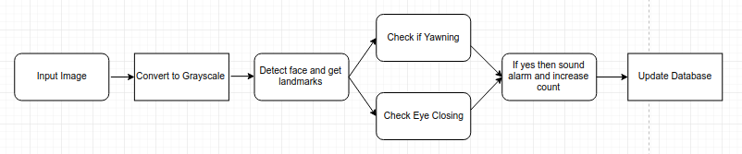
How we do it?
The system checks that the driver is having trouble staying actions, it will take corrective action and record.
Here’s what detection system does:

Slide 9
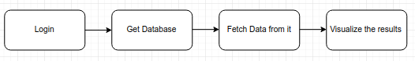
And..
For optimizing the performance of businesses and to remove possible drivers that are more probable to sleep the number of mishappening can be kept under a check. We use specialized infographics to present data in a more human readable and presentable form.

Slide 10
Business model
For optimizing the performance of businesses and to remove possible drivers that are more probable to sleep the number of mishappening can be kept under a check. We use specialized infographics to present data in a more human readable and presentable form. The client will be provided with a website to access the records of his drivers fleet and having the access of all of the drivers at one touch away will prove profitable for his corporate. Also the legal burden will be lessened because of less number of accidents as well as less accidents will also lead to less damage to trucks so securing profits on financial side too. Overall the software will help clients to pick the best performing drivers for his fleet without much trouble.

Slide 11
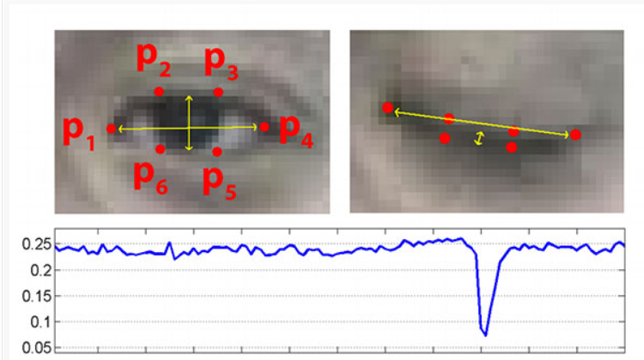
DEMONSTRATION

Slide 12
conclusion
The driver abnormality monitoring system developed is capable of detecting drowsiness, drunken and reckless behavior of driver in a short time. The proposed system can prevent the accidents due to the sleepiness while driving. The system works well even in case of drivers wearing spectacles and even under low light conditions if the camera delivers better output. Information about the head and eyes position is obtained through various self-developed image processing algorithms. During the monitoring, the system is able to decide if the eyes are opened or closed. When the eyes have been closed for too long, or he yawns a warning signal is issued. processing judges the driver’s alertness level on the basis of continuous eye closures and the amount of yawning.

Slide 13
THANK YOU!

